Slide 1
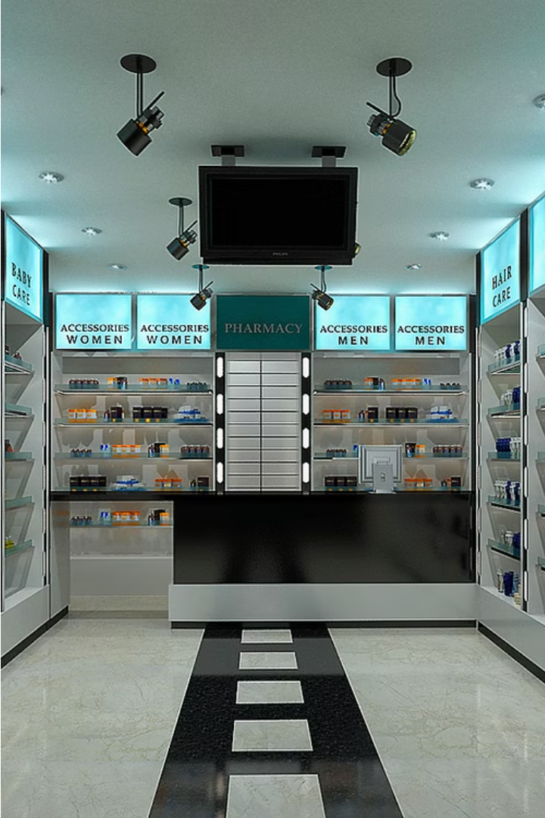
OPP JAVA SEMESTER PROJECT with mysql database
Introduction to Pharmacy Management System
Streamline your pharmacy operations with our comprehensive Pharmacy Management System. This powerful software solution helps you efficiently manage inventory, patient records, and financial transactions, enabling you to focus on providing exceptional patient care.
aa
by ahmad hassan

Slide 2

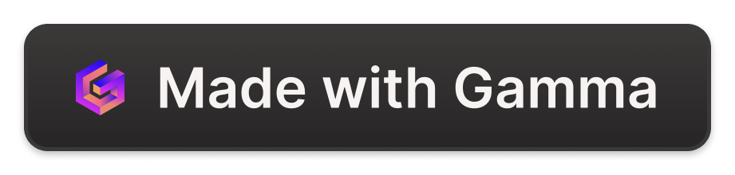
Problem Statement
Currently, managing the pharmacy manually is slow and error-prone, leading to issues such as delayed medicine deliveries, inaccurate inventory levels, and potential risks to patient safety due to mistakes. There is a pressing need for a computerized Pharmacy Management System (PMS) to address these challenges. This system should improve efficiency by automating tasks, accurately tracking medicine inventory, simplifying prescription filling, and enhancing overall operations. Additionally, it should be capable of generating daily and monthly reports to provide insights into pharmacy performance and trends. Integration with existing healthcare systems, compliance with regulations, real-time data availability, and user-friendly interfaces are essential features required for the system to optimize workflow and ensure the best possible patient care.

Slide 3
Solution Approach
The current manual system for managing pharmacy operations lacks efficiency and transparency, leading to issues such as inaccurate stock management, unrecorded sales transactions, and inadequate control over user access. There is a need for a comprehensive Pharmacy Management System (PMS) that facilitates CRUD operations, user authentication, stock tracking, sales recording, and role-based access control. This system should address the challenges faced by administrators and employees in managing medicines, handling sales, and ensuring accountability while providing a user-friendly interface and robust security measures.

Slide 4
MODULES
Authentication Module
Inventory Management Module
Sales Recording Module
Billing and Purchase Module
Reporting Module
Role-Based Access Control (RBAC) Module
DATABASE MYSQL TO STORE DATA

Slide 5

Manager Functionalities
As the pharmacy management system's manager, you'll have a wide range of capabilities to ensure the smooth operation of the business. From managing employee accounts to overseeing inventory and generating comprehensive sales reports, the manager's role is crucial in driving the pharmacy's success
Employee functionalities
Employee can sale medicine print bill he can print bill .He can see all available stock and can search medicine by name
.

Slide 6
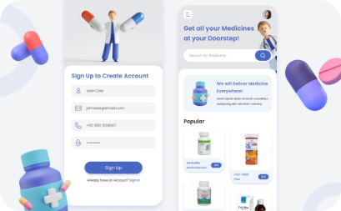

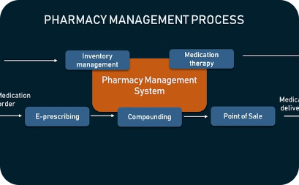
Sign In/Sign Up For Admin and employee
Secure Sign-In
Streamlined Sign-Up
Role-Based Access
The Pharmacy Management System features a robust sign-in process that ensures only authorized users can access the platform. Managers and employees can securely log in using their unique credentials, protecting sensitive information and maintaining the integrity of the system.
New users, whether managers or employees, can easily register for the system through a straightforward sign-up process. This allows them to quickly set up their accounts and start leveraging the powerful features of the Pharmacy Management System to improve operations and customer service.
The sign-in and sign-up process is designed to differentiate between managers and employees, granting each user the appropriate level of access and functionality based on their assigned role. This ensures the system is secure and that users can only perform tasks aligned with their responsibilities.

Slide 7




Inventory management
Create
Read
Update
Delete
The manager can add new products, employees, and customer accounts to the pharmacy management system. This allows them to easily onboard new items and personnel as the business grows.
Managers can view detailed information about existing products, employees, and customer accounts. This provides valuable insights into inventory, staffing, and sales trends to help inform business decisions.
Managers can edit details of products, employee records, and customer accounts as needed. This allows them to keep the pharmacy management system up-to-date with the latest information.
Managers can remove products, employee records, and customer accounts from the system when they are no longer needed. This helps maintain an organized and streamlined database.

Slide 8

Stock Management
Inventory Tracking
Low Stock Alerts
The pharmacy management system should provide real-time visibility into current inventory levels. Managers can easily see which medicines are in stock, their quantities, and when they need to be reordered to avoid stockouts.
The system should automatically generate low stock alerts when certain medicines reach preset minimum thresholds. This allows managers to take proactive measures to reorder supplies and maintain adequate stock levels to meet customer demand.
Expiration Management
To minimize waste, the system should track expiration dates for all medicines and provide alerts when products are nearing their expiration. Managers can then prioritize the sale of soon-to-expire items and rotate stock accordingly.

Slide 9
Sales Reporting
Daily Sales Report
Monthly Sales Analytics
The pharmacy management system allows the manager to generate a daily sales report, providing a detailed breakdown of all transactions made that day. This report includes the total sales, the number of prescriptions filled, and the top-selling products.
In addition to the daily report, the manager can access a comprehensive monthly sales report. This report analyzes trends, identifies best-selling products, and highlights any significant changes in sales patterns over time. This valuable data helps the manager make informed decisions to optimize inventory and marketing strategies.

Slide 10
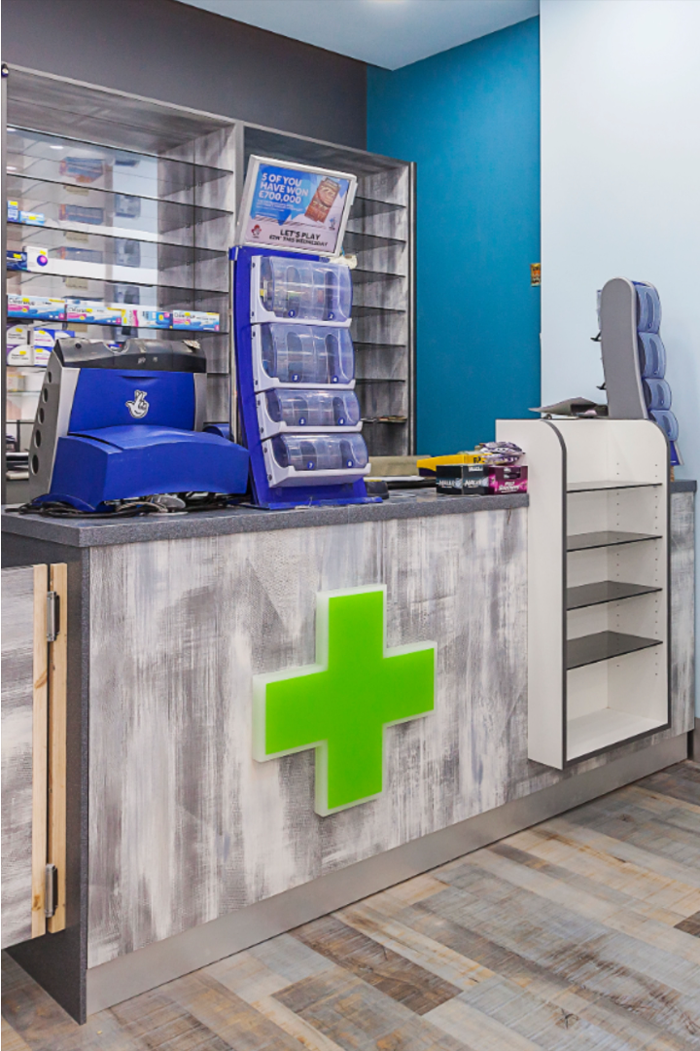
Billing and Purchase
Billing
The billing module allows users to generate detailed invoices for customer purchases. It automatically calculates taxes, discounts, and total amounts due, making the checkout process seamless and error-free.
Purchase
The purchase order module streamlines the process of ordering new inventory from suppliers. Users can create and track purchase orders, receive shipments, and reconcile invoices, ensuring efficient stock management.

Slide 11
Thank You

